Slide 1


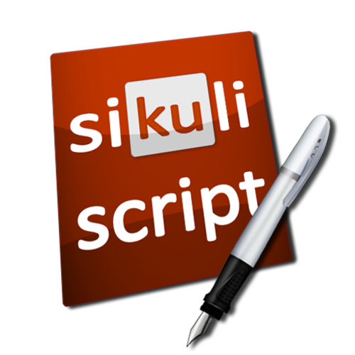


Sikuli Visual UI Automation
QA
Fundamentals
Ivomir Assi
QA Engineer
AppBuilder team
Telerik

Slide 2

Table of Contents (1)
What is a Capture/Replay tool
Introducing Sikuli
What we need to run Sikuli
How Sikuli works
Sikuli IDE
Test folder structure
Cross-Platform

Slide 3
Table of Contents (2)
8. Advantages
9. Limitation
10. Advanced Sikuli Functions

Slide 4

What is a Capture/Replay tool
The test developer interacts with an application under test, typically through the graphical user interface (GUI), while some capture tool simultaneously generates an automated test script
Limitation of Capture/Replay tool:
Lots of repeated lines of code (DRY?)
Not human readable
Difficult to maintenance

Slide 5
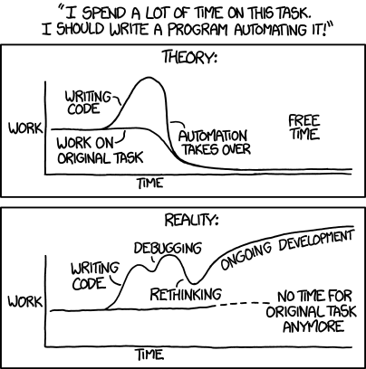
Automation: Theory VS Reality

Slide 6
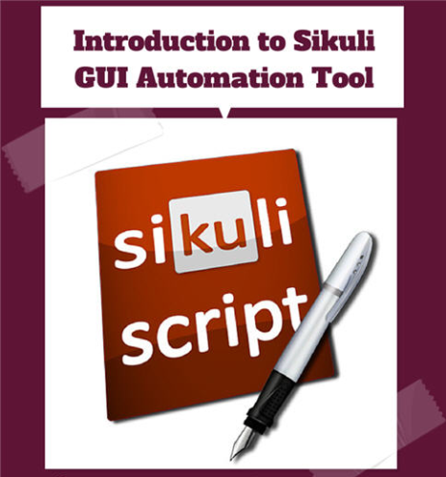
Introduction to Sikuli
Screenshot driven – it is a visual technology to search, recognize and automate GUI with images
Open-source visual scripting tool
Scripts are written in Jython - Jython is an implementation of the high-level, dynamic, object-oriented language Python seamlessly integrated with the Java platform

Slide 7



What we need to run Sikuli
Sikuli 1.0.1 (Official)
Java 7 32-bit version
Windows, Mac or Linux OS
Sikuli 1.1 (Beta)
Java 8 32-bit version
Windows, Mac or Linux OS
Download and install Sikuli
http://www.sikuli.org/download.html

Slide 8
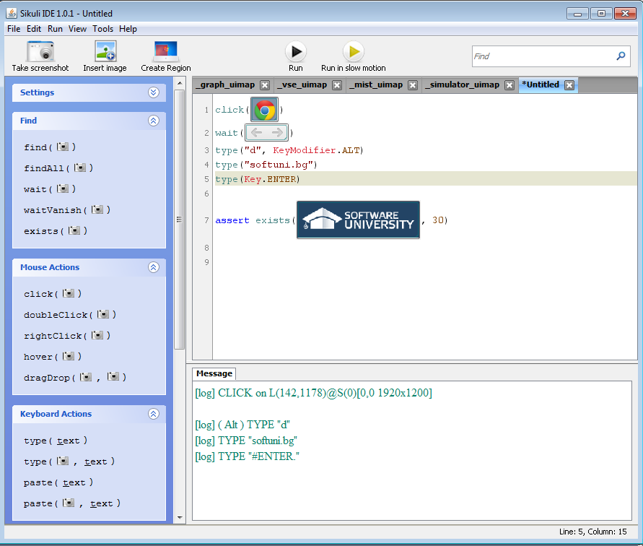
How Sikuli works
Combination of GUI & Traditional coding
Jython coding that can use images as parameters and variables
Screen Capture for image selection instead of xpath, IDs
Upload a custom image
Image pattern settings
Similarity
Target offset

Slide 9
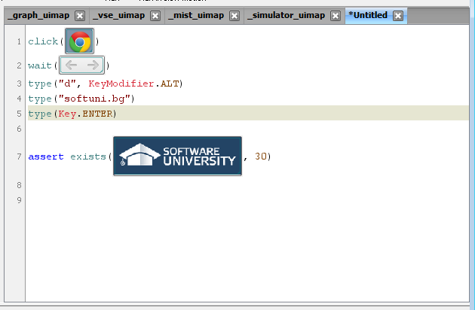
Using Sikuli IDE (1)
Editor for writing Sikuli scripts

Slide 10
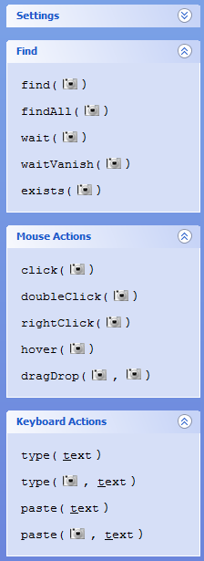
Using Sikuli IDE (2)
Basic Sikuli function:
Find – find, wait, exists
Mouse Actions – click, dragDrop, hover
Keyboard Actions – type, paste
Others – highlight, switchApp

Slide 11
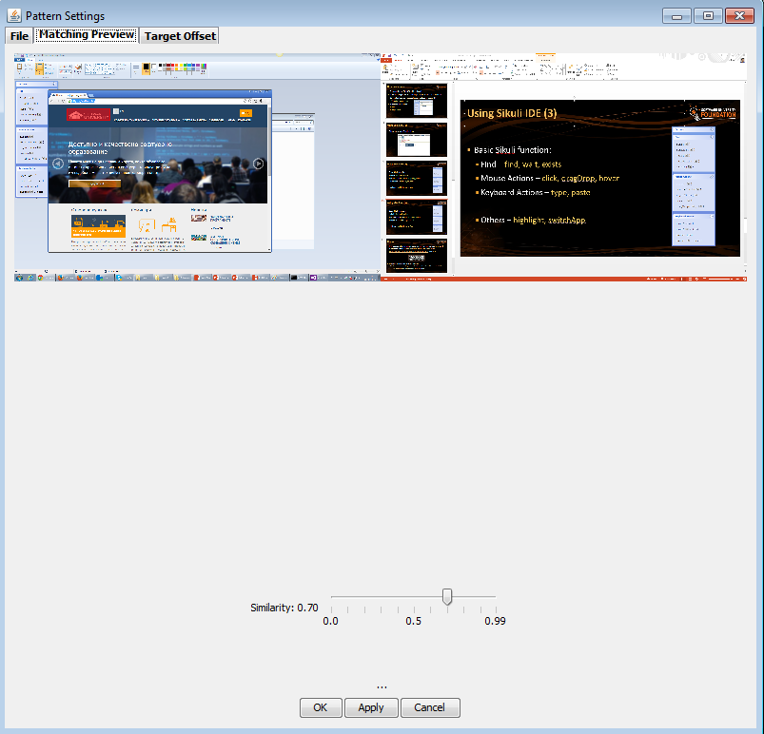
Using Sikuli IDE (3)
Image pattern settings
Matching Preview – Similarity
Target offset

Slide 12
Sikuli IDE Demo

Slide 13




Test folder structure
Sikuli script directory (.sikuli) contains:
Python source file (.py)
Images files (.png)
HTML file (.html) – generated after save in Sikuli IDE

Slide 14
Cross-platform tool
Works on any GUI which can be displayed on Windows/Mac/Linux
Virtual machines
Remote Desktop
Simulators
Desktop applications
Web

Slide 15


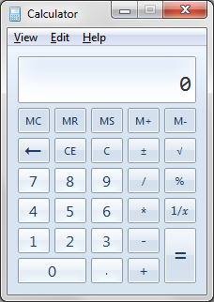

Cross-Platform demo
Switching between
Web (softuni)
Desktop App (Calculator)
Video (Youtube)
Web (Mtel)

Slide 16

Advantages
Cross-Platform tool
Intuitive and natural approach
Reproduce user actions

Slide 17

Limitations
Sikuli operates only in the visible screen
UI elements can be easily affected from:
Changes in OS
OS Themes
Fonts
Browser updates!

Slide 18
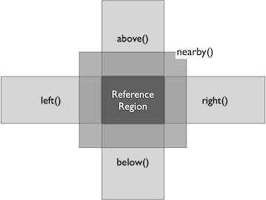
Advanced Sikuli Functions
Regions – Region(x, y, w, h)
Finding regions – find()
Acting with regions – region.highlight, click, type
Extending region:
region.offset(x,y)
region.nearby()
region.above()
region.below()
region.left()
region.right()
Region Docs - http://doc.sikuli.org/region.html

Slide 19
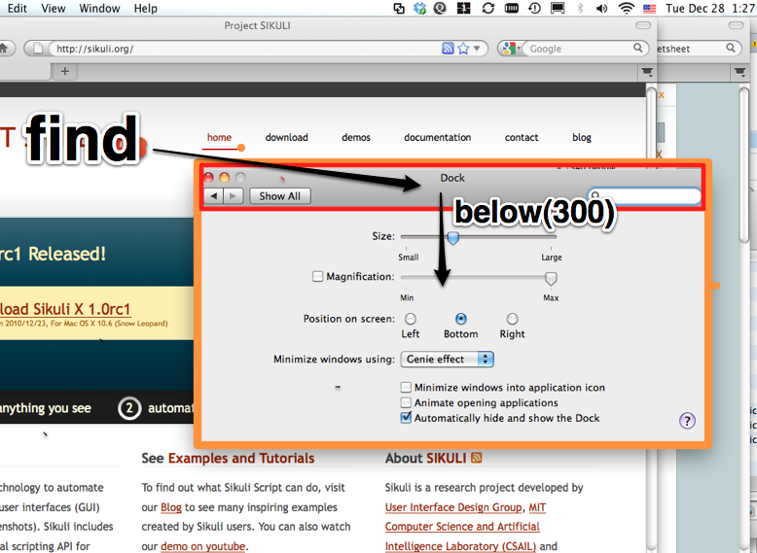
Regions Demo

Slide 20
Resources
Sikuli site:
http://www.sikuli.org/
Sikuli documentation:
http://doc.sikuli.org/

Slide 21
License
This course (slides, examples, demos, videos, homework, etc.) is licensed under the "Creative Commons Attribution-NonCommercial-ShareAlike 4.0 International" license
Attribution: this work may contain portions from
“Software Quality Assurance - Part II" course by Telerik Academy under CC-BY-NC-SA license

Slide 22





Free Trainings @ Software University
Software University Foundation – softuni.org
Software University – High-Quality Education, Profession and Job for Software Developers
softuni.bg
Software University @ Facebook
facebook.com/SoftwareUniversity
Software University @ YouTube
youtube.com/SoftwareUniversity
Software University Forums – forum.softuni.bg

